Slide 1
A Vehicle Crash Simulator Using Digital Twin Technology for Synthesizing Simulation and Graphical Models
Name :Sushana Islam Mim
ID :22273001
Course :Petri Net Theory And Modeling Of Systems
Faculty :Annajiat Alim Rasel [AAR]

Slide 2
Introduction:
This proposal introduces a vehicle crash simulator that combines simulation and animation components. The simulator synthesizes and simulates models of vehicles and their surroundings, then animating outcomes based on simulation results. It aims to validate the simulator's ability to deliver collision and non-collision outcomes by considering the speeds of two vehicles at an intersection, filling a critical gap in vehicle simulation.

Slide 3
Related works
vehicle Driving Simulators Various vehicle simulators serve multiple purposes, including accident collision simulation, self-driving vehicle testing, and data collection.
Notable simulators in this category are as follows: LG AD Simulator: A Unity-based photorealistic simulator from South Korea, supporting autonomous driving test and verification (HIL and VIL), software development (SIL), and data generation.
NVIDIA Drive Sim: A cloud-based simulator from the USA offering physically accurate simulations for autonomous vehicle development, data generation, and human interaction testing.
For a quick comparison, summarizes their key features and support in various simulation scenarios.These simulators play a crucial role in vehicle development, testing, and validation, each offering unique capabilities and advantages for specific applications.

Slide 4
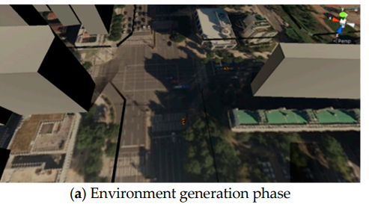
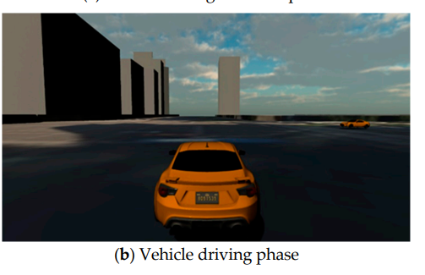
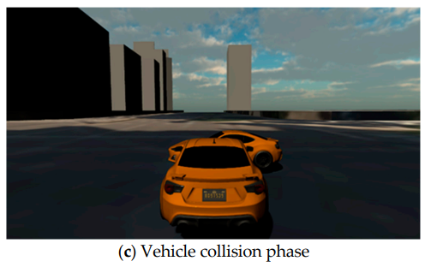
Animation Component:
The animation component is used to visualize the Simpy model state as an output result that expresses movement.This component helps to easily express processes and results of vehicle changes using the Unity engine.When our simulator expresses the simulation model as an animation, information for the event schedule and state transition of each event is exchanged as JSON data.

Slide 5
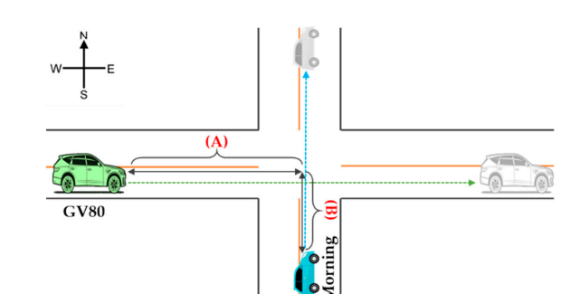
results:
The experiment involved a high-speed Genesis GV 80 and a slow-moving KIA Morning at an intersection. The collision scenario involved traffic light changes from red to green, and the simulation used fundamental physics laws like acceleration and impulse to model and simulate the collision.

Slide 6
conclusion:
Limitations of Existing Simulators: Existing vehicle simulators, such as the LG AD Simulator and NVIDIA Drive Sim, excel at precisely visualizing vehicle movement in 3D environments but primarily focus on individual vehicle testing. They face challenges in representing collisions between vehicles in diverse and complex environments.

